Slide 1
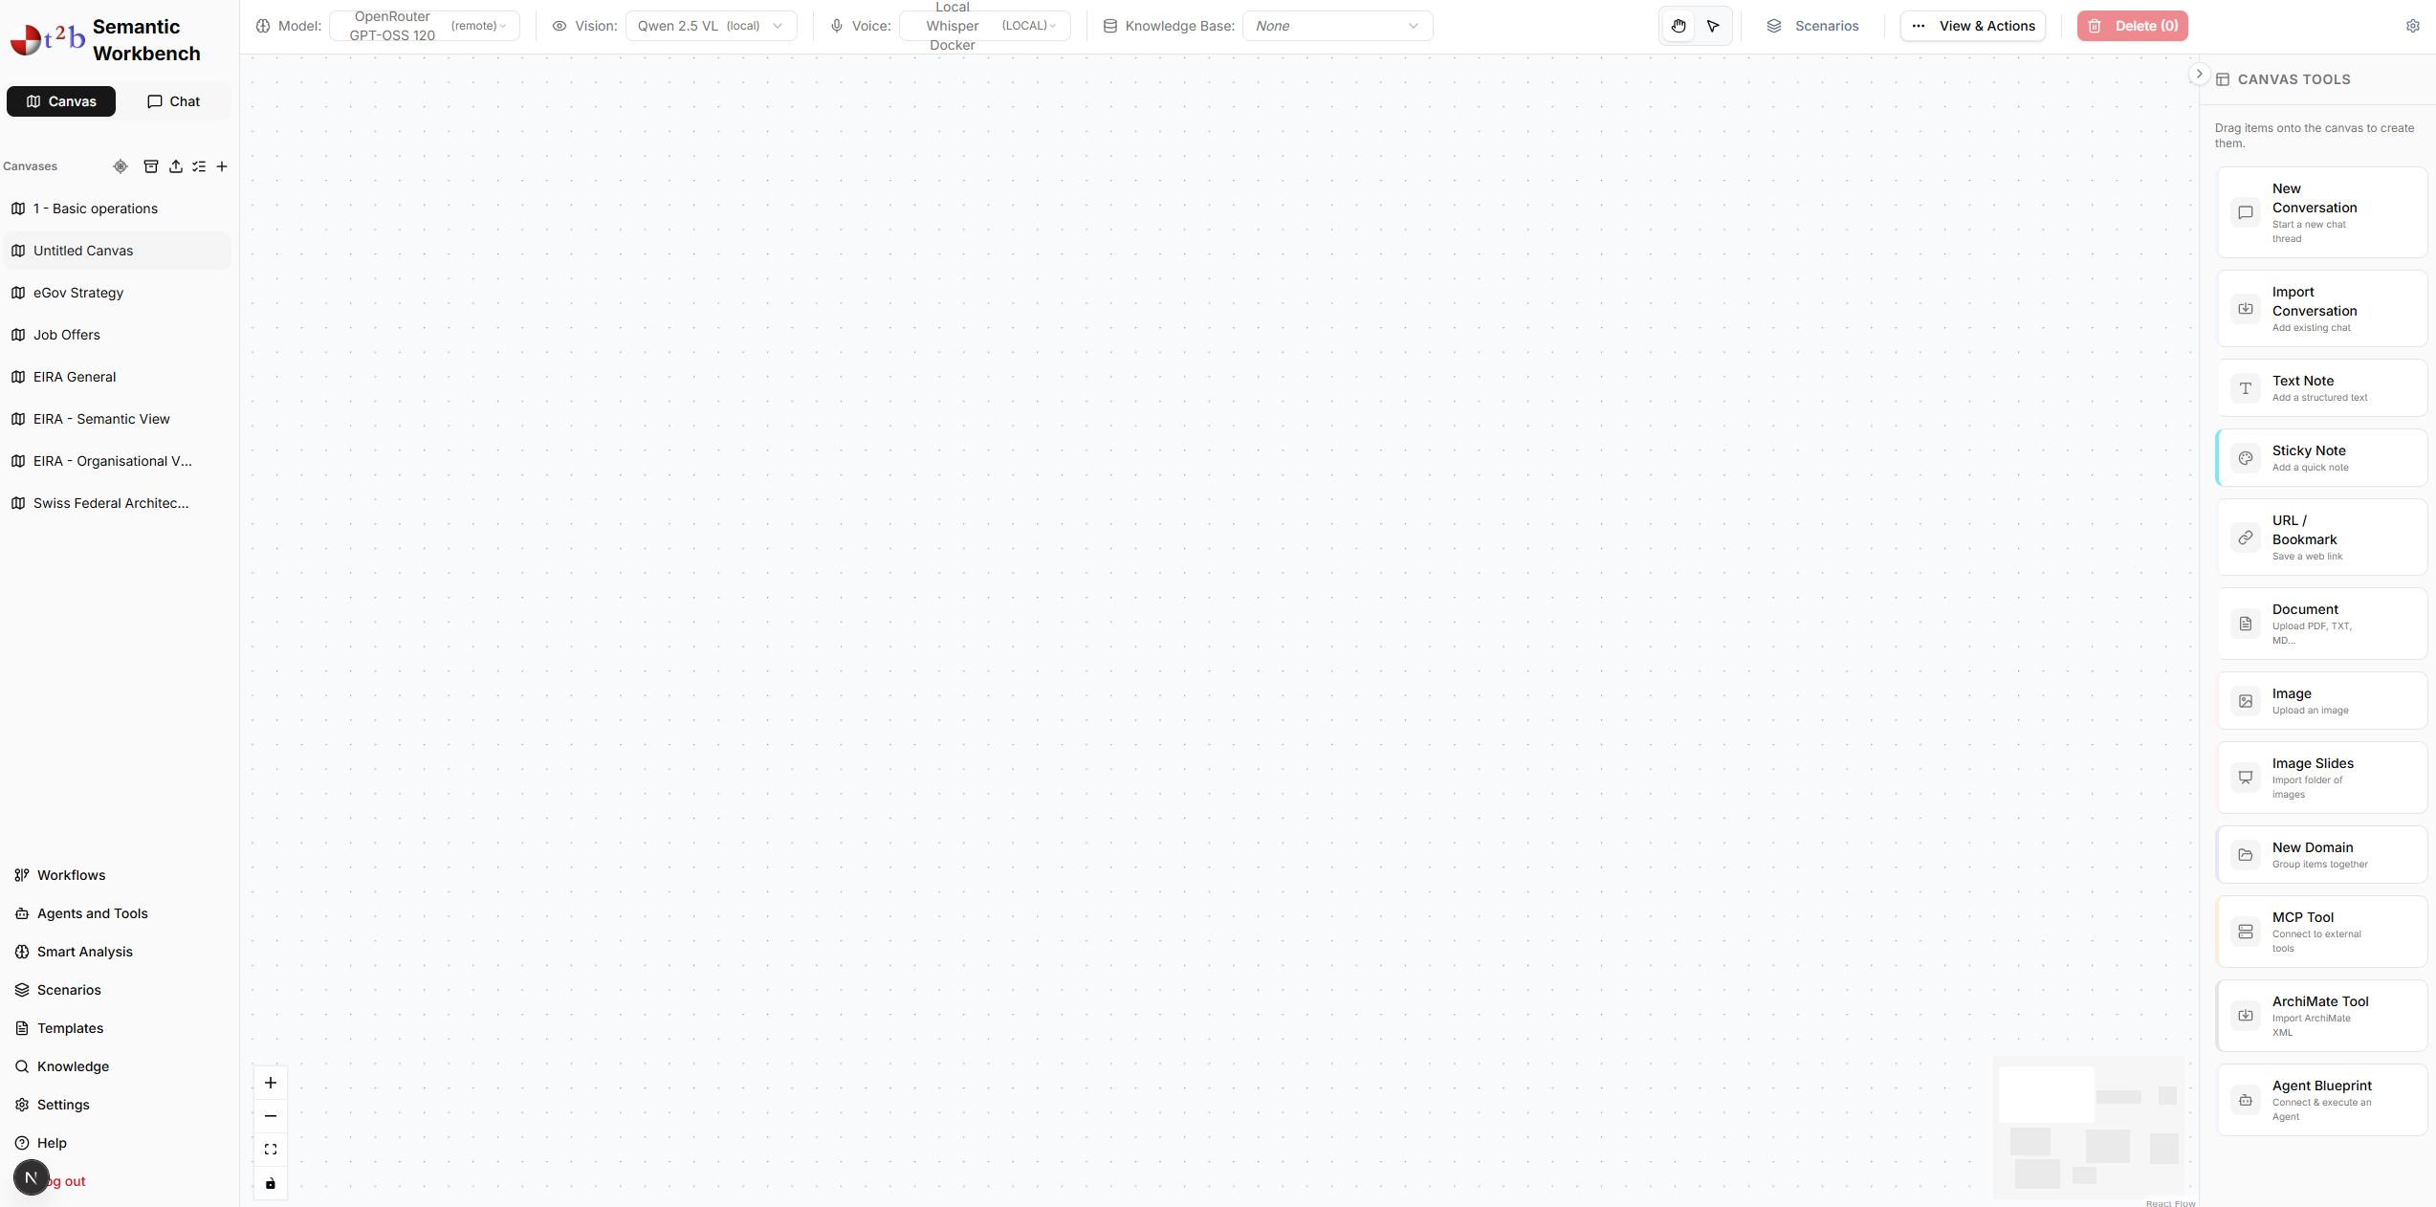
The Canvas
The “Canvas" is an infinite, spatial workspace where notes, files, and data transform into structured intelligence through direct manipulation.
Create a Workspace
Launch your investigation by clicking the "+" icon next to Canvases in the Sidebar navigation hub.
Every canvas is a fresh start for non-linear thinking and complex organization.
Identity & History
Rename your canvas easily via the Sidebar history. Simply click on the 3-dots or to edit its label.
Your work is saved automatically, accessible anytime from the secure History panel.

Slide 2
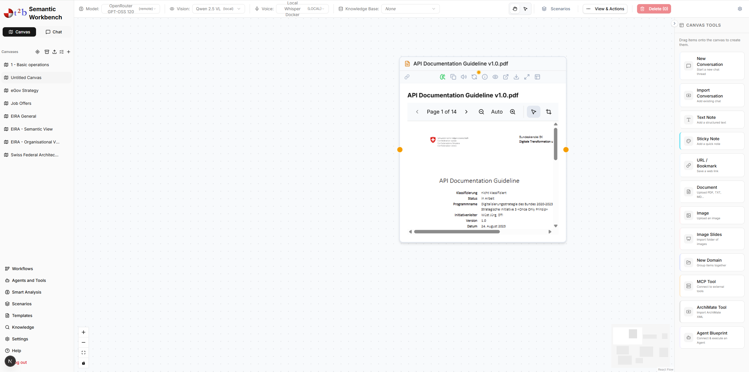
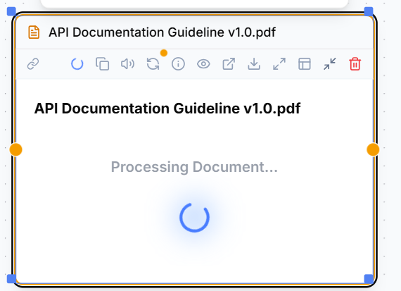
Populating the Workspace
Drag & Drop
Instantly add PDFs, images, or text files directly onto the canvas surface.
Or use the Canvas tools to add a “Thing”
RAG
When you add a document, the Ingestion Pipeline converts raw text and visual elements into high-dimensional vector embeddings.
This "Notion of Vectorization" allows the AI to perform deep semantic searches, finding relevant context across pages.

Slide 3
The Master Toolbox
Hand Tool
Pointer Tool
Navigate the infinite workspace. Use Drag or the zoom box to pan effortlessly across large projects.
Select, move, and resize nodes. Use the “Pointer tool” to group multiple items for arrangement.
Model Selection
Choose the AI model that will power operations on this canvas.
Vision Model: Select a specialized model for image analysis.

Slide 4
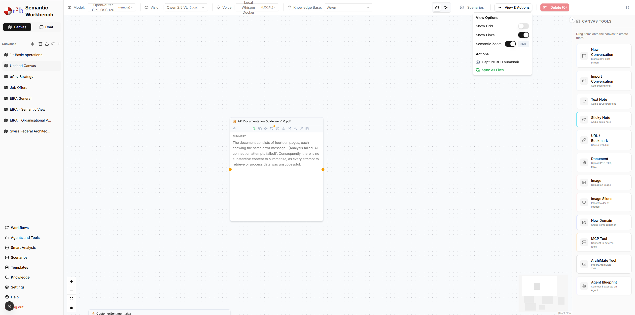
Semantic Zoom
Semantic Zoom
Clarity at Every Scale: Dynamic level-of-detail management ensures you never lose the big picture.
As you zoom out, nodes automatically condense into high-level labels and one-liners. Zoom in to reveal full text, metadata, and editing controls.
This allows for massive projects that remain navigable and visually clean.

Slide 5
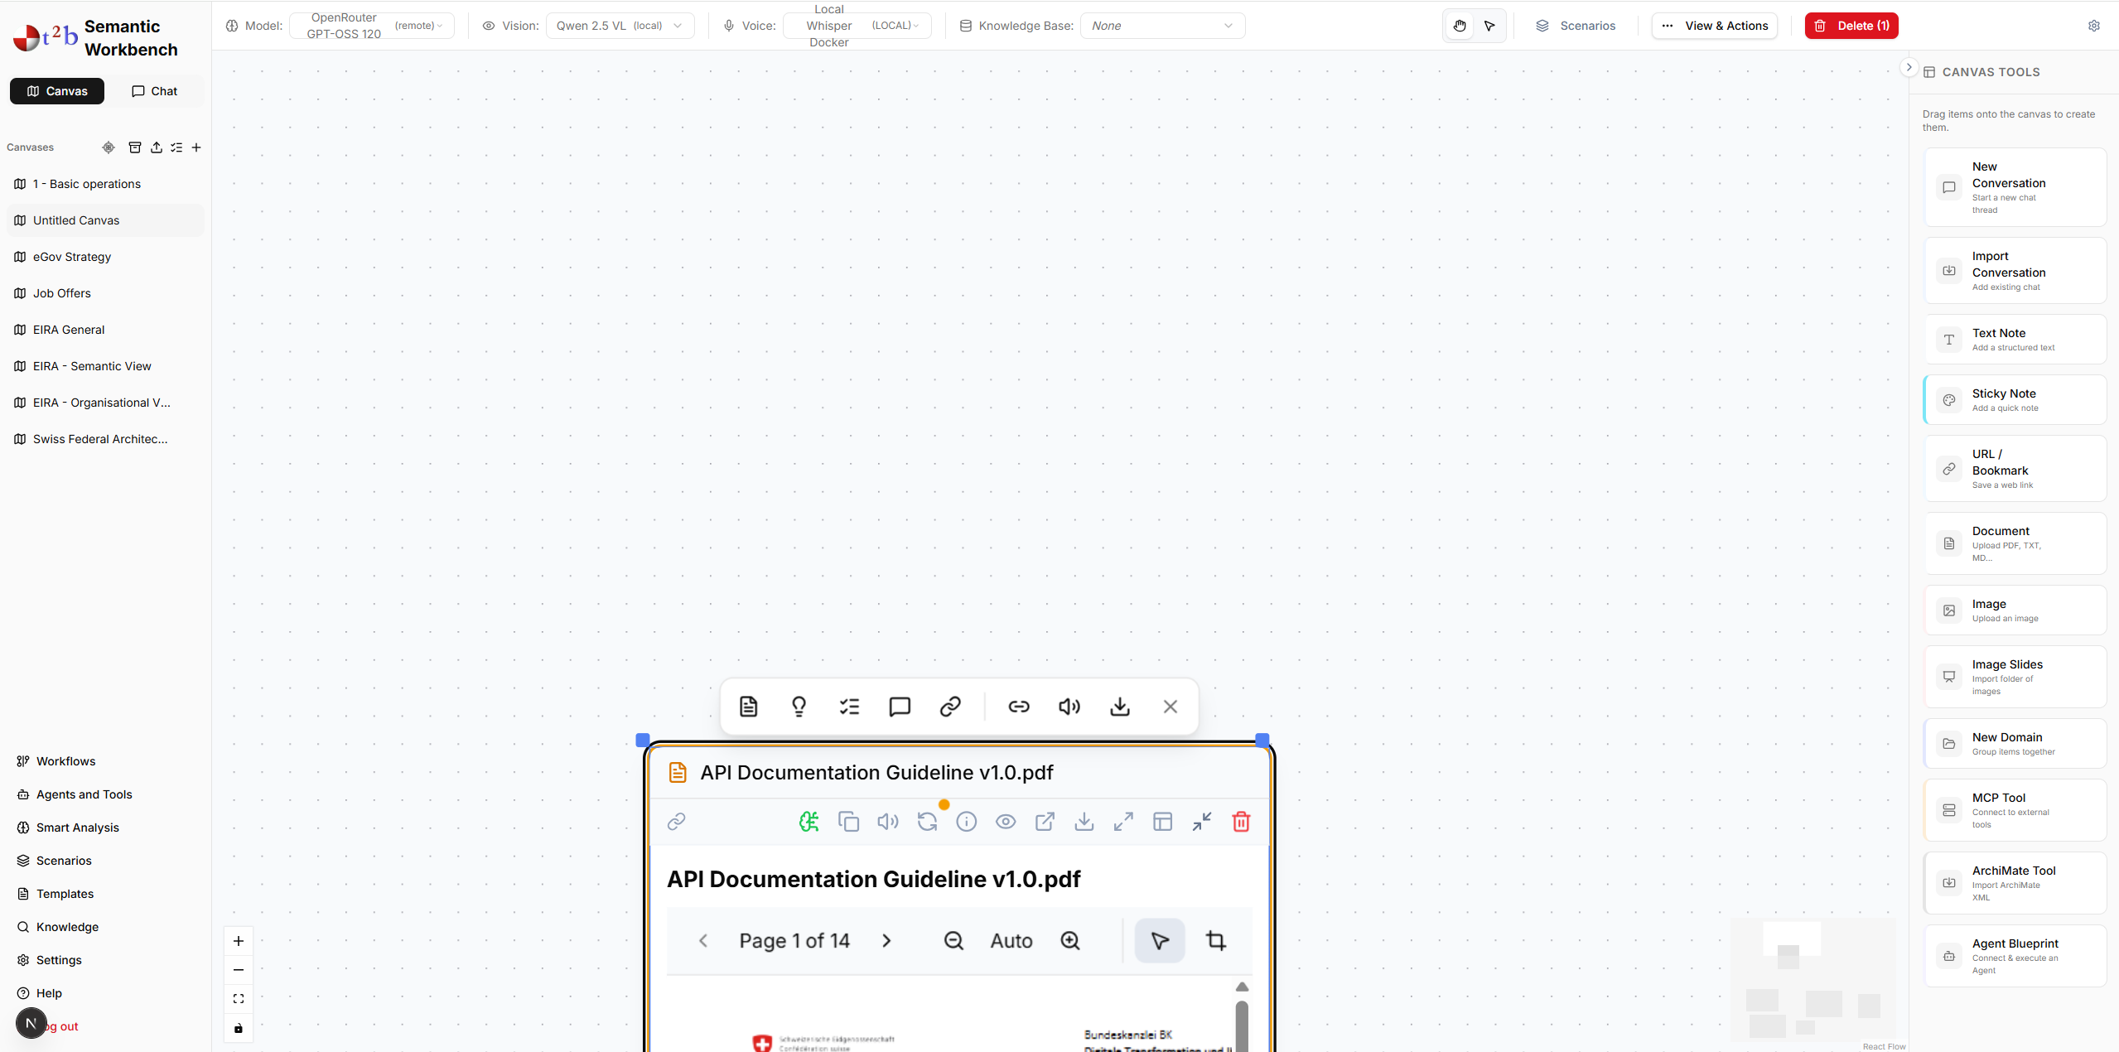
Contextual Toolbox
Summarize
Explain
Main Points
Conversation
Condense the selected content into a concise brief.
Get deep insights and context for complex segments.
Extract core arguments and actionable bullet points.
Start a targeted AI chat about the selection.

